Slide 1

LlamaIndex
A Central Interface between LLM’s + your external data
https://github.com/jerryjliu/llama_index

Slide 2

Context
LLMs are a phenomenal piece of technology for knowledge generation and reasoning. They are pre-trained on large amounts of publicly available data.
Use Cases
Question-Answering
Text Generation
Summarization
Planning
LLM’s

Slide 3
















Context
How do we best augment LLMs with our own private data?
Raw Files
API’s
?
Use Cases
Question-Answering
Text Generation
Summarization
Planning
Vector Stores
SQL DB’s
LLM’s

Slide 4
Paradigms for inserting knowledge
Fine-tuning - baking knowledge into the weights of the network
Before college the two main things I worked on, outside of school, were writing and programming. I didn't write essays. I wrote what beginning writers were supposed to write then, and probably still are: short stories. My stories were awful. They had hardly any plot, just characters with strong feelings, which I imagined made them deep...
LLM
RLHF, Adam, SGD, etc.

Slide 5
Paradigms for inserting knowledge
Fine-tuning - baking knowledge into the weights of the network
Downsides:
Data preparation effort
Lack of transparency
Doesn’t work well
High upfront cost

Slide 6
Paradigms for inserting knowledge
In-context learning - putting context into the prompt
Before college the two main things I worked on, outside of school, were writing and programming. I didn't write essays. I wrote what beginning writers were supposed to write then, and probably still are: short stories. My stories were awful. They had hardly any plot, just characters with strong feelings, which I imagined made them deep...
Input Prompt
Here is the context:
Before college the two main things…
Given the context, answer the following question: {query_str}
LLM

Slide 7
Key challenges of in-context learning
How to retrieve the right context for the prompt?
How to deal with long context?
How to deal with source data that is potentially very large? (GB’s, TB’s)
How to tradeoff between:
Performance
Latency
Cost

Slide 8
LlamaIndex: A interface between your data and LLMs
Data management + query engine
Our goal is to make this interface fast, cheap, efficient, and performant
Data Ingestion (LlamaHub 🦙)
Data Structure
Query Interface
Connect your existing data sources and data formats (API’s, PDF’s, docs, SQL, etc.)
Store and index your data for different use cases. Integrate with different db’s.
Feed in an input prompt and obtain a knowledge-augmented output.

Slide 9




LlamaIndex
Knowledge-Intensive LLM Applications
Sales
Marketing
Recruiting
Dev
Legal
Finance
…
Input: rich query description
Output: rich response with references, actions, etc
LlamaIndex
Data Interface for LLM app development
Foundation Models

Slide 10
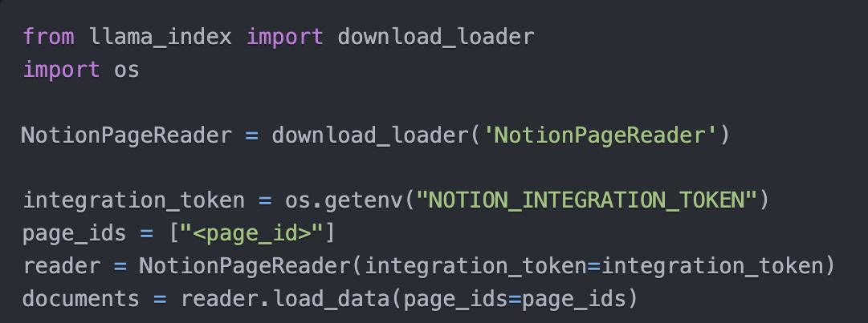
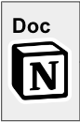
Data Connectors: powered by LlamaHub 🦙
Easily ingest any kind of data, from anywhere
into unified document containers
Powered by community-driven hub
rapidly growing (90+ loaders and counting!)
Growing support for multimodal documents (e.g. with inline images)
<10 lines of code to ingest from Notion

Slide 11
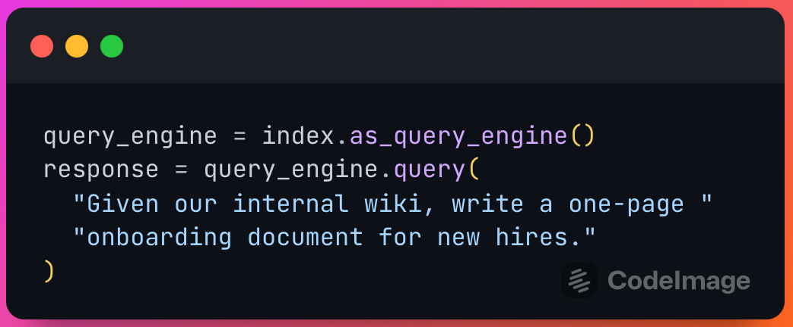
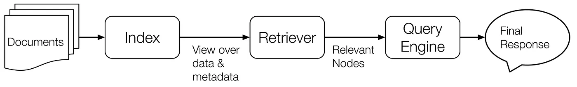
Data Indices + Query Interface
Your source documents are stored in a data collection
In-memory, MongoDB
Our data indices help to provide a view of your raw data
Vectors, keyword lookups, summaries
A retriever helps to retrieve relevant documents for your query
A query engine manages retrieval and synthesis given the query.
Let’s walk through a few examples!

Slide 12
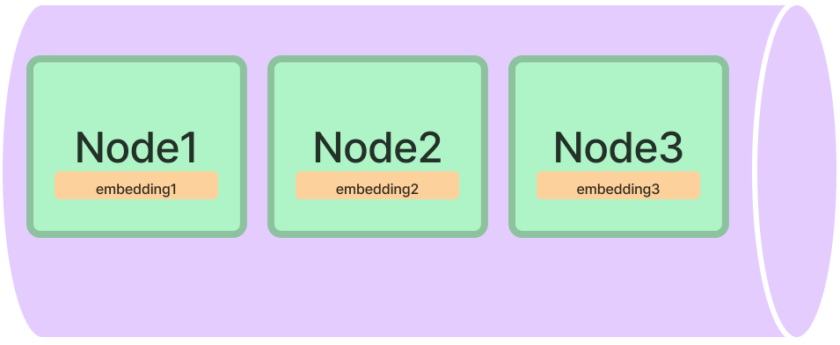
Vector Store Index
Raw Documents
Stored as Nodes in a vector store
Each Node is indexed with an embedding
Doc
Doc
Doc
Vector Store
Node1
Node2
Node3
Embedding1
Embedding2
Embedding3

Slide 13
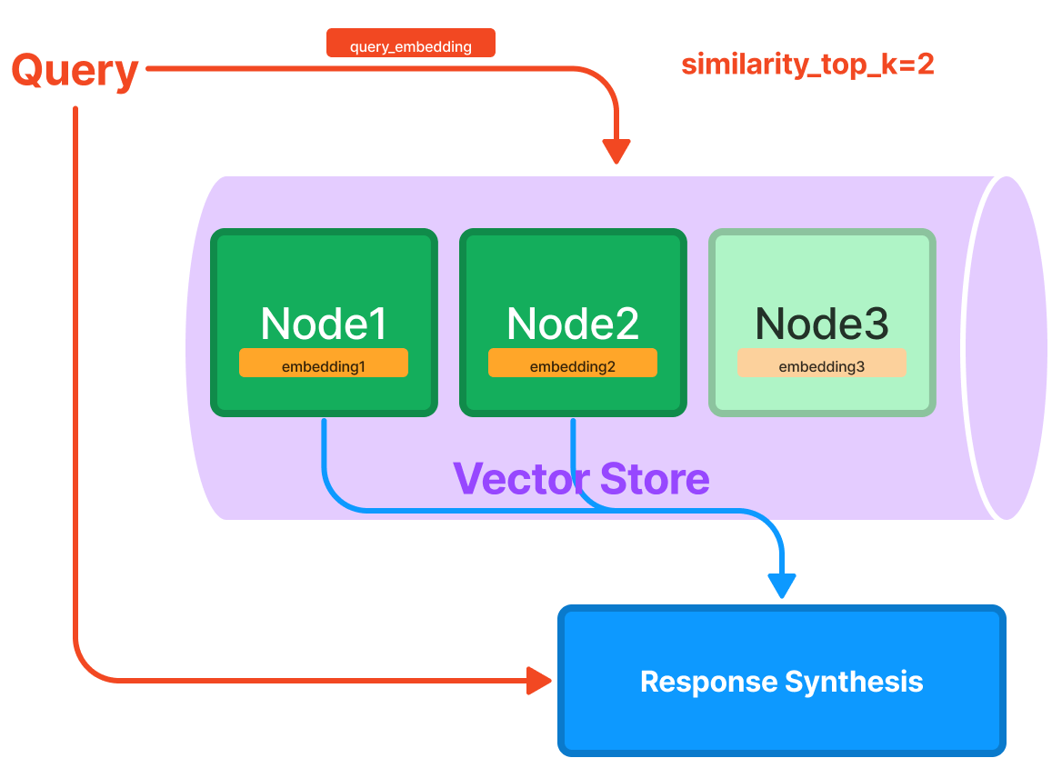
Vector Store Index

Slide 14
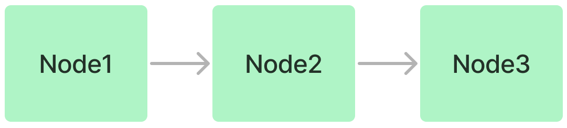
List Index
Doc
Data Ingestion
Doc
Doc

Slide 15
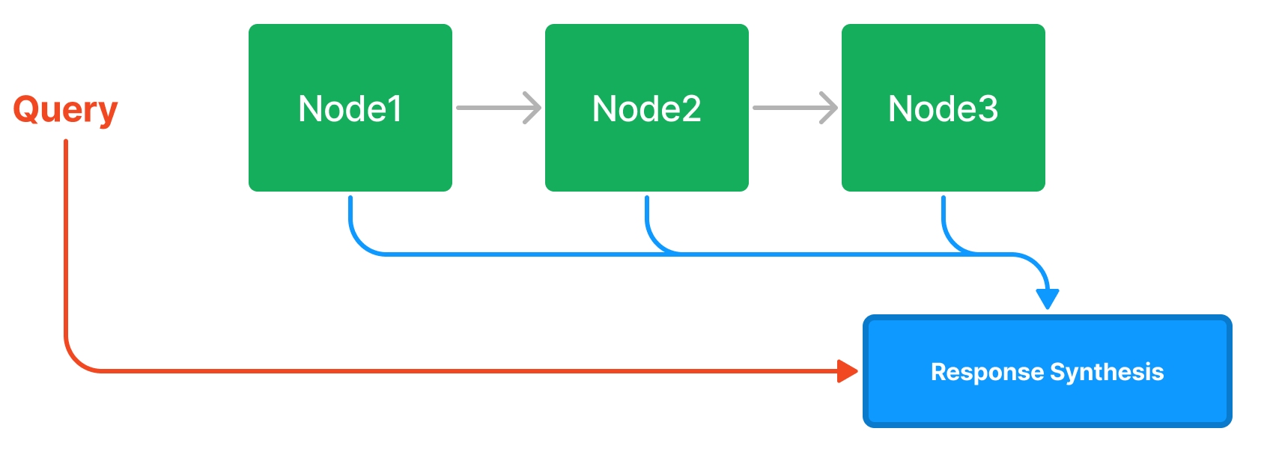
List Index

Slide 16
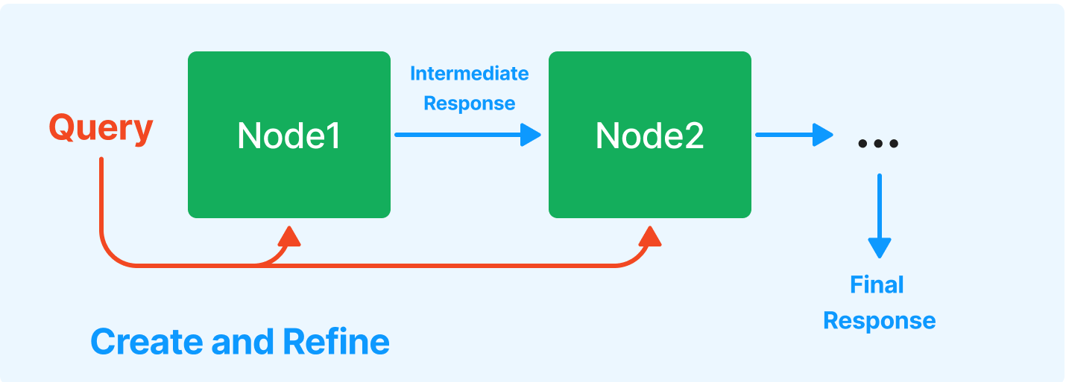
Response Synthesis
Create and refine

Slide 17
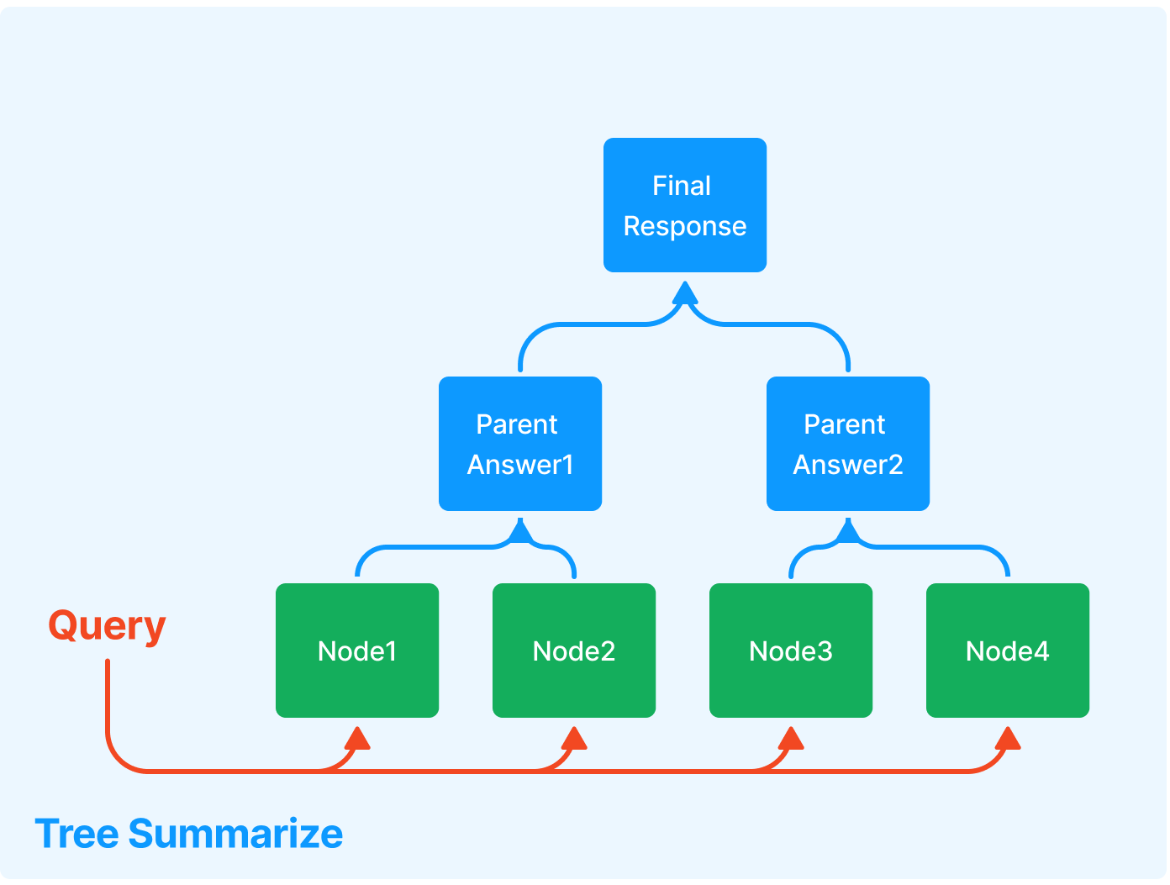
Response Synthesis
Tree Summarize

Slide 18
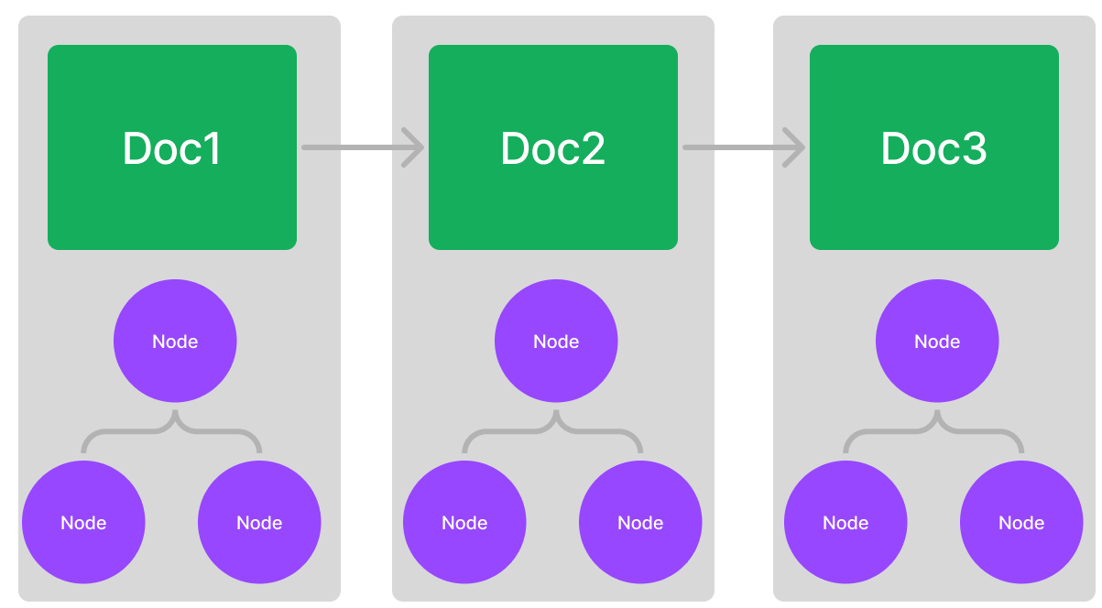
[More advanced] Composing a graph

Slide 19
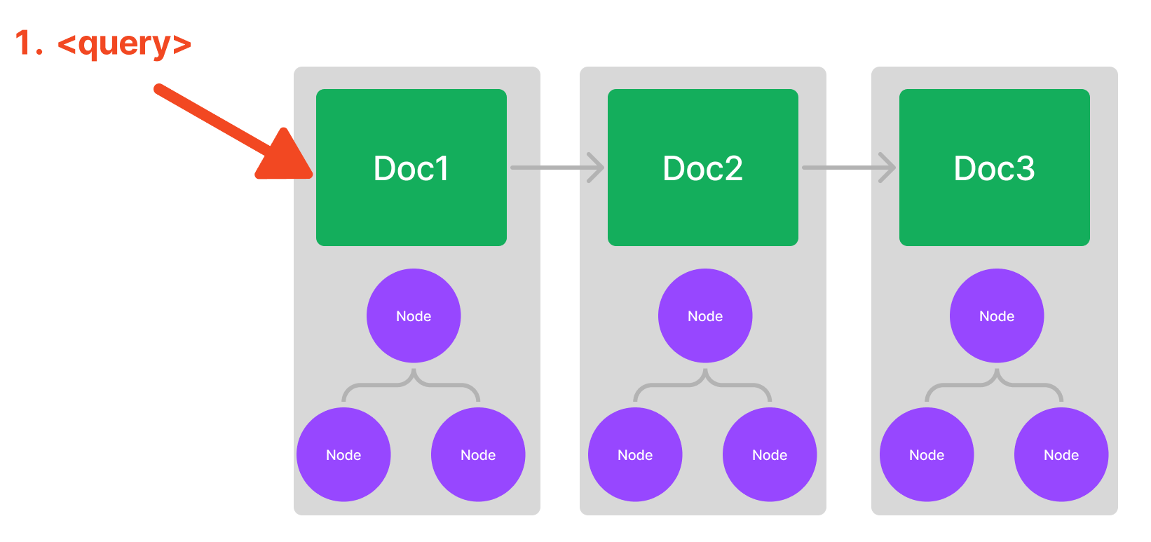
[More advanced] Composing a graph

Slide 20
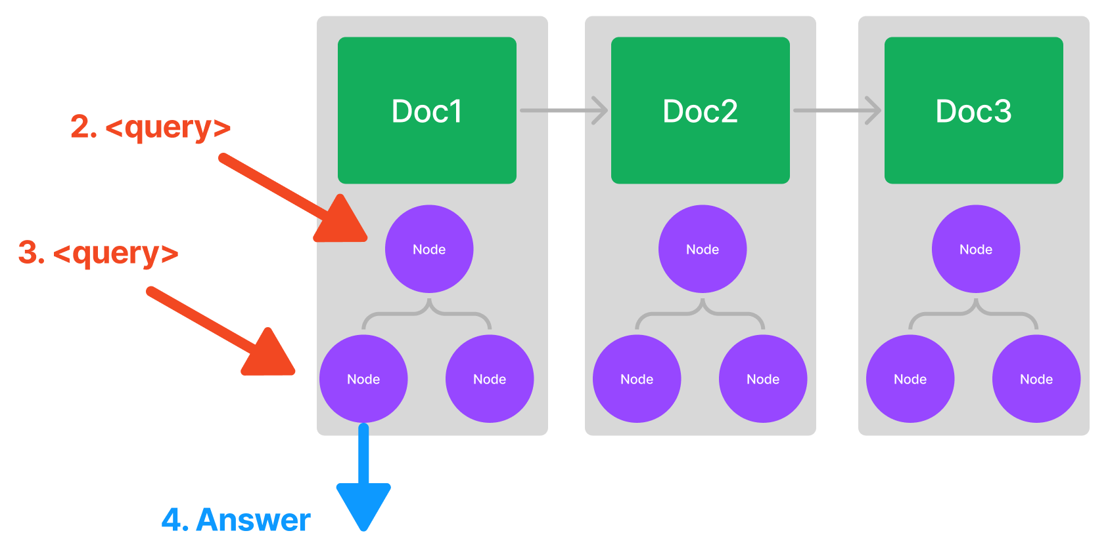
[More advanced] Composing a graph

Slide 21

Demo Walkthrough
Let’s play around with LlamaHub + index + query!
Easily ingest data
https://colab.research.google.com/drive/12cdBWMpOfCxpiAS1zSqZRY66o84qMiTo?usp=sharing

Slide 22
Use Case: Semantic Search
from llama_index import GPTVectorStoreIndex, SimpleDirectoryReader
documents = SimpleDirectoryReader('data').load_data()
index = GPTVectorStoreIndex.from_documents(documents)
query_engine = index.as_query_engine(response_mode="tree_summarize")
response = query_engine.query(
"What did the author do growing up?"
)
Answer
The author grew up writing short stories, programming on an IBM 1401, and working on microcomputers. He wrote simple games, a program to predict how high his model rockets would fly, and a word processor. He studied philosophy in college, but switched to AI. He reverse-engineered SHRDLU for his undergraduate thesis and wrote a book about Lisp hacking. He visited the Carnegie Institute and realized he could make art that would last.

Slide 23
Use Case: Summarization
from llama_index import GPTListIndex, SimpleDirectoryReader
documents = SimpleDirectoryReader('data').load_data()
index = GPTListIndex.from_documents(documents)
query_engine = index.as_query_engine(response_mode="tree_summarize")
response = query_engine.query("Could you give a summary of this article in newline separated bullet points?")
Answer
The author began writing and programming before college, and studied philosophy in college before switching to AI.
He realized that AI, as practiced at the time, was a hoax and decided to focus on Lisp hacking instead.
He wrote a book about Lisp hacking and graduated with a PhD in computer science.
….

Slide 24
Use Case: Text-to-SQL (Structured Data)
from llama_index import GPTSQLStructStoreIndex, SQLDatabase
sql_database = SQLDatabase(engine, include_tables=["city_stats"])
# NOTE: the table_name specified here is the table that you
# want to extract into from unstructured documents.
index = GPTSQLStructStoreIndex.from_documents(
wiki_docs,
sql_database=sql_database,
table_name="city_stats",
)
# set Logging to DEBUG for more detailed outputs
query_engine = index.as_query_engine(mode="default")
response = query_engine.query("Which city has the highest population?")
print(response)
SQL Guide
https://gpt-index.readthedocs.io/en/latest/guides/tutorials/sql_guide.html
Generated SQL
SELECT city_name, population FROM city_stats ORDER BY population DESC LIMIT 1

Slide 25
Use Case: Synthesis over Heterogeneous Data
from llama_index import GPTVectorStoreIndex, GPTListIndex
from llama_index.indices.composability import ComposableGraph
index1 = GPTVectorStoreIndex.from_documents(notion_docs)
index2 = GPTVectorStoreIndex.from_documents(slack_docs)
graph = ComposableGraph.from_indices(GPTListIndex, [index1, index2], index_summaries=["summary1", "summary2"])
response = graph.as_query_engine().query("Give me a summary of these two articles")
In this example, we compose an index over other indexes (a list index over vector indexes)
The query will be routed to both simple vector indexes!

Slide 26
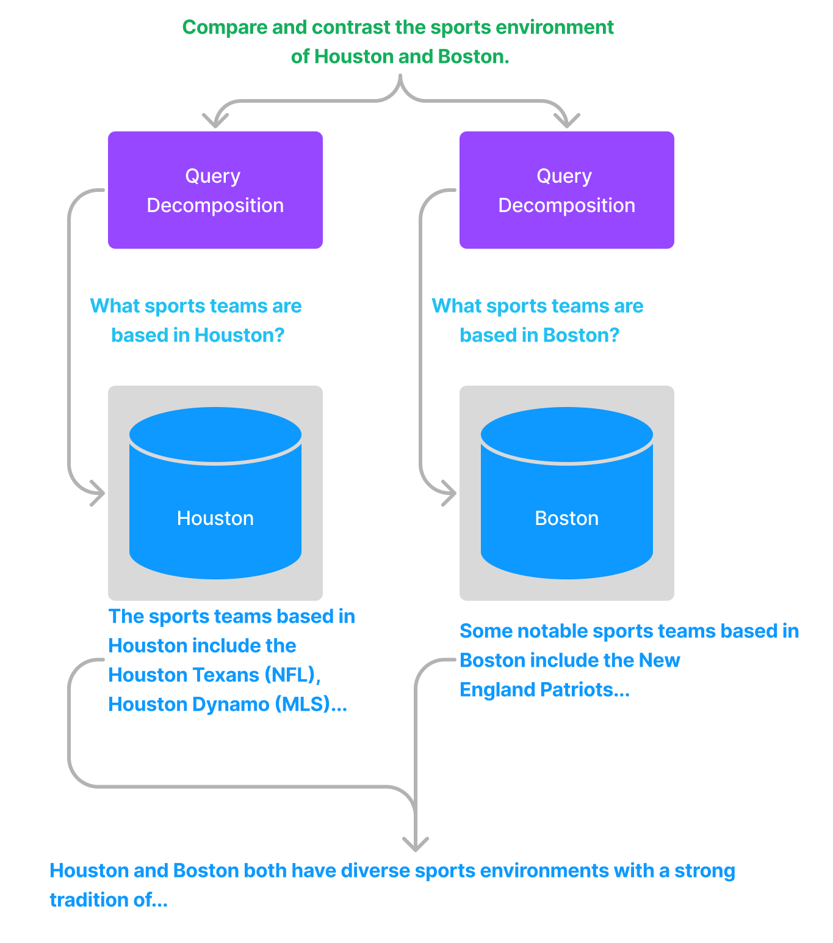
Use Case: Compare/Contrast Queries
A special case of synthesis over heterogeneous data.
Here, a query transform can help!
Notebook:
https://github.com/jerryjliu/llama_index/blob/main/examples/composable_indices/city_analysis/City_Analysis-Decompose.ipynb

Slide 27
Use Case: Multi-Step Queries
Break a complex query into multiple simpler ones!
Chain-of-thought prompting over an existing data source.
Notebook:
https://github.com/jerryjliu/llama_index/blob/main/examples/vector_indices/SimpleIndexDemo-multistep.ipynb

Slide 28
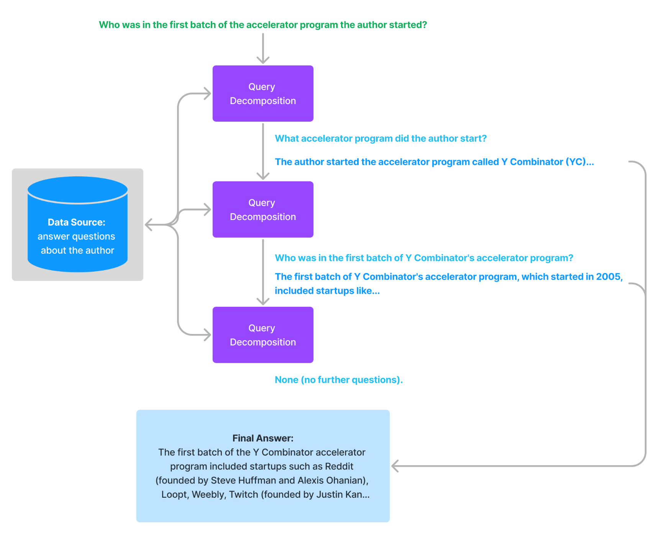

Slide 29
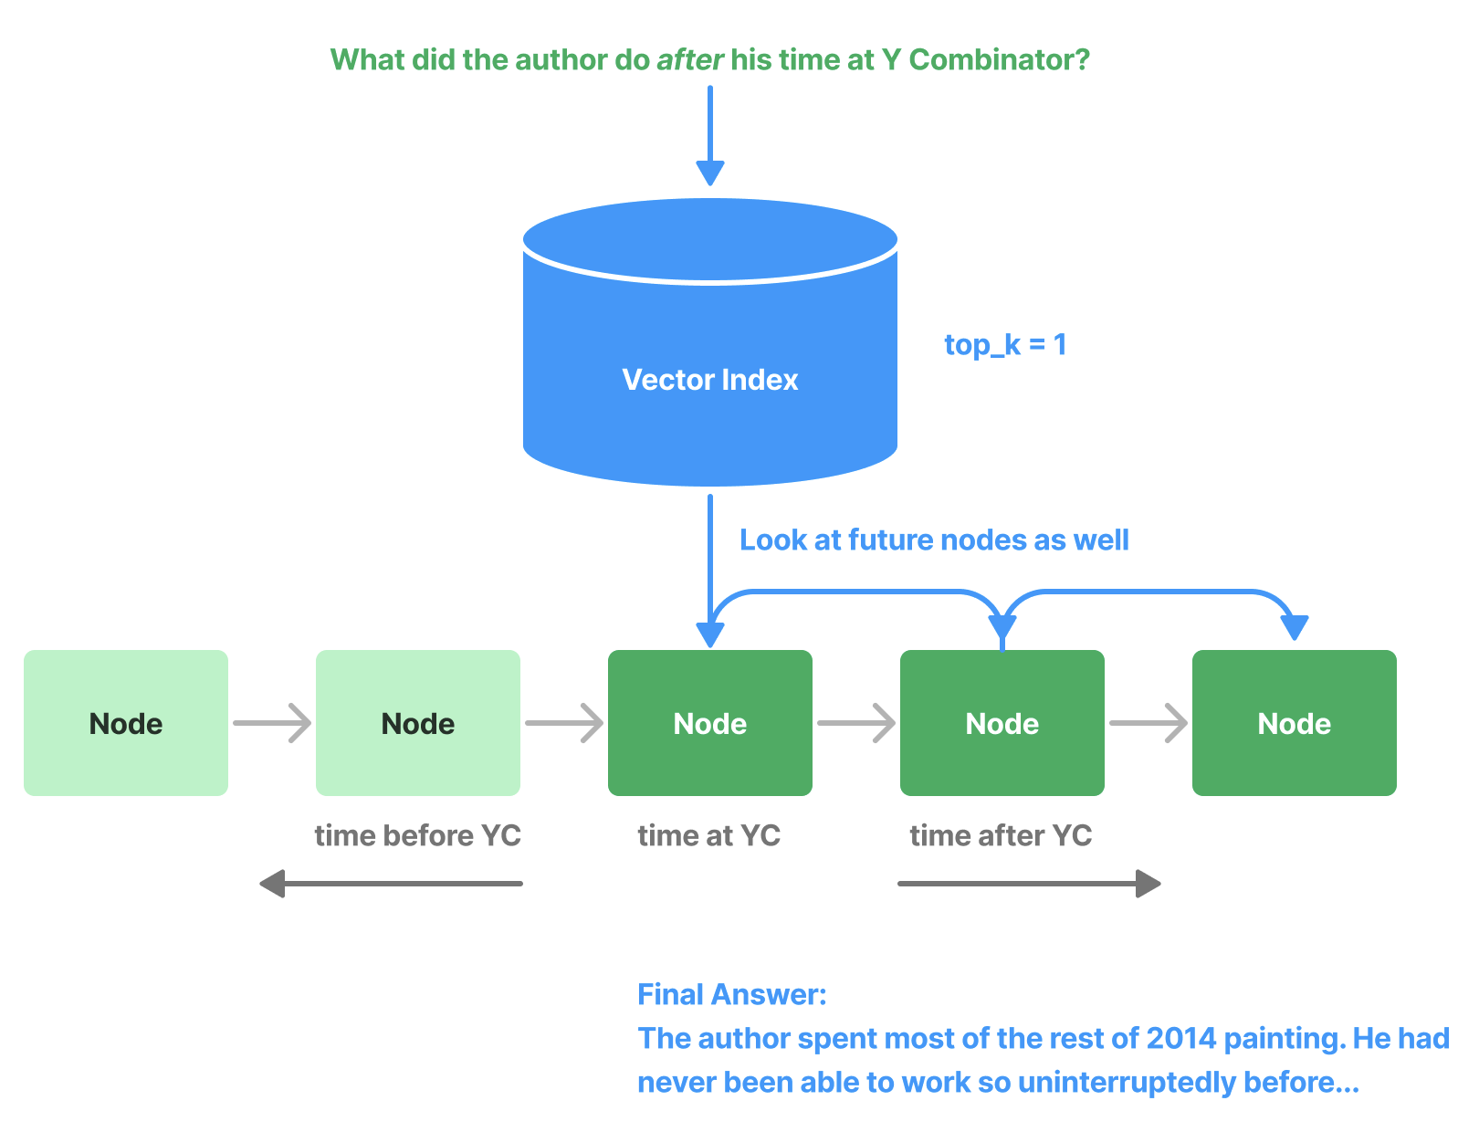
Use Case: Exploiting Temporal Relationships
Given a question, what if we would like to retrieve additional context in the past or the future?
Example question: “What did the author do after his time at Y Combinator?”
Requires looking at context in the future!

Slide 30
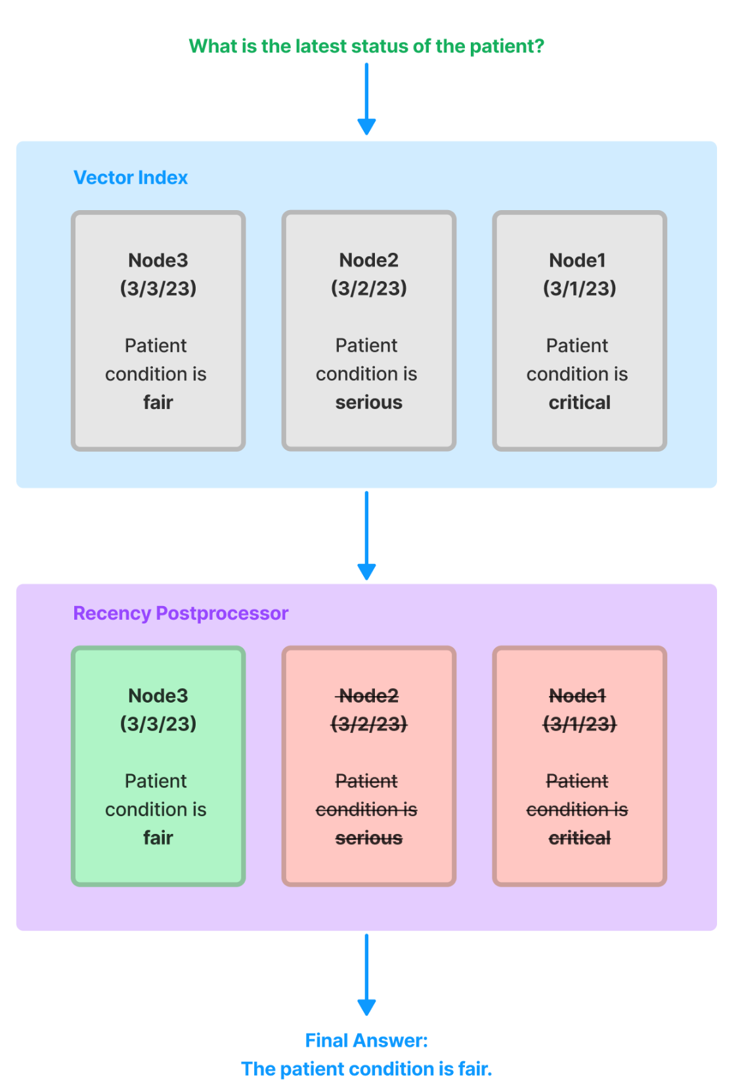
Use Case: Recency Filtering / Outdated nodes
Imagine you have three timestamped versions of the same data.
If you ask a question over this data, you want to make sure it’s over the latest document.

Slide 31

Integration into Downstream Apps
Build a chatbot with LlamaIndex + Langchain
https://gpt-index.readthedocs.io/en/latest/guides/tutorials/building_a_chatbot.html

Slide 32
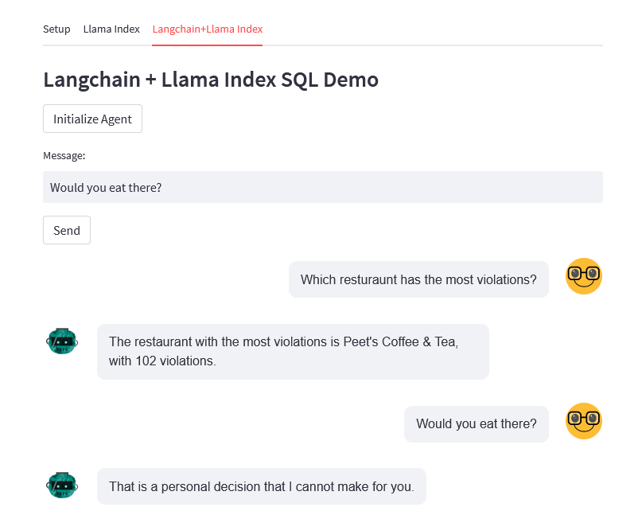
Integration into Downstream Apps
Build a Streamlit app!
https://huggingface.co/spaces/llamaindex/llama_index_sql_sandbox

Slide 33
More Demo Walkthroughs!
Building a custom retriever
https://github.com/jerryjliu/llama_index/blob/main/examples/query/CustomRetrievers.ipynb

Slide 34
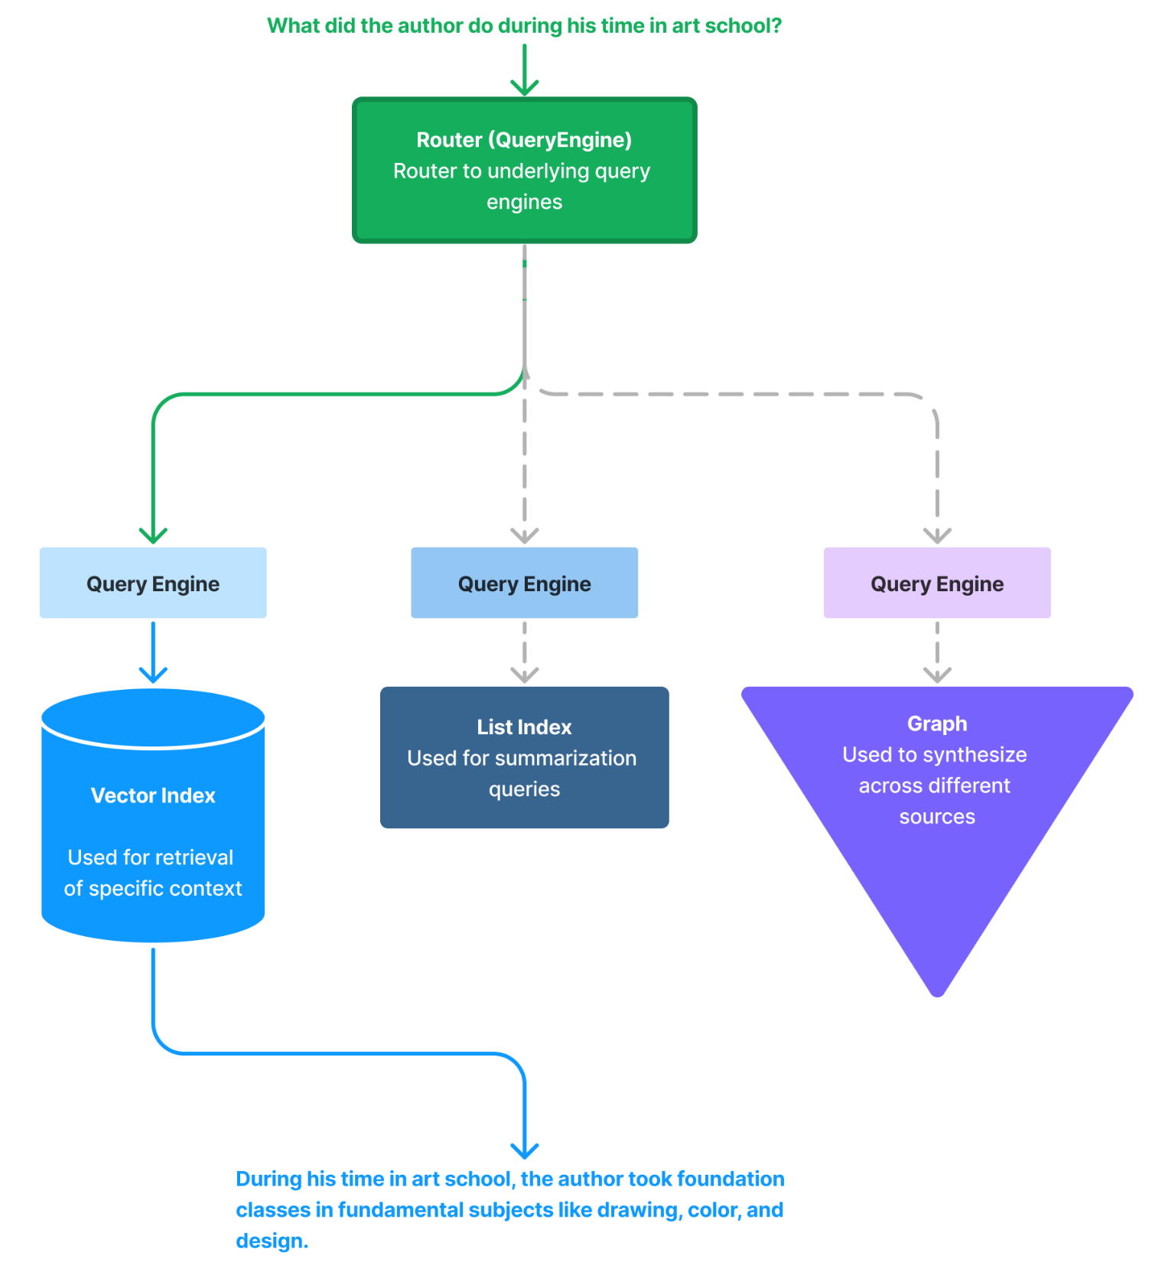
More Demo Walkthroughs! [Advanced]
Building a unified query interface
https://colab.research.google.com/drive/1KH8XtRiO5spa8CT7UrXN54IWdZk3DDxl?usp=sharing

